Slide 1
SOLE OF THE FOOT
BY
DR. OGWUCHE ELIJAH
(BSc. MSc. MB,BS)
LAGOS STATE UNIVERSITY COLLEGE OF MEDICINE (LASUCOM),IKEJA.

Slide 2
OUTLINE
INTRODUCTION
SKIN
FASCIA
SKELECTAL FRAMEWORK
LAYERS
COMPARTMENTS
NERVE SUPPLY
BLOOD SUPPLY
CLINICAL SIGNIFICANCE
REFERENCES

Slide 3
INTRODUCTION
SOLE OF THE FOOT; This is the plantar surface of the foot and correspond to the palm of the hand.
It is the part of the foot that makes contact with the floor when standing barefooted.
The skin of the sole like the palm is hairless with numerous sweat gland

Slide 4
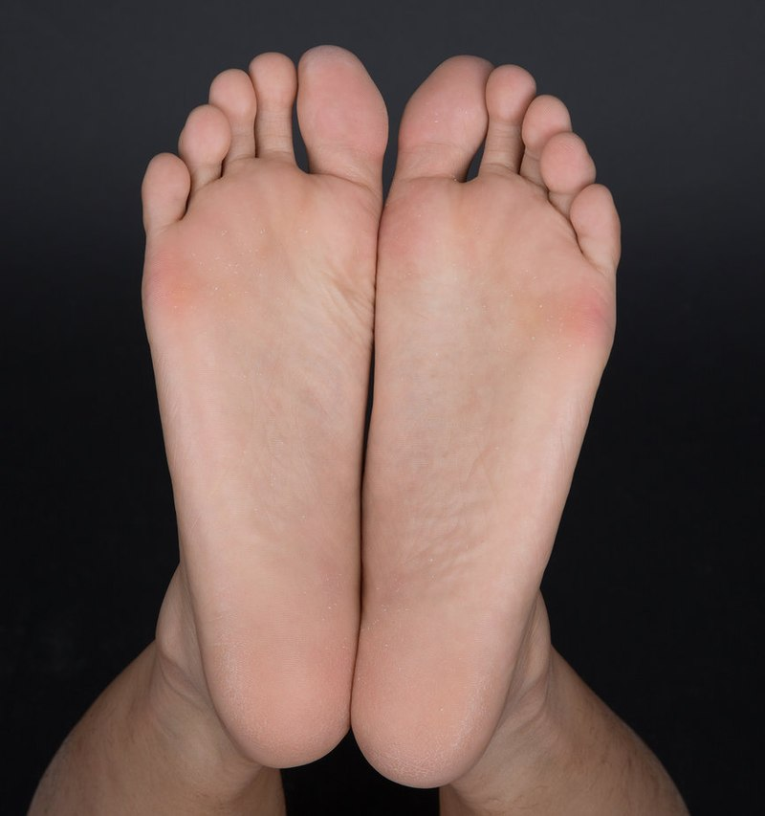
INTRODUCTION CONT’D

Slide 5
SKIN
It is thick for protection
Firmly adherent to the underlying plantar aponeurosis
It is creased
The nerve supply of the skin include;
- medial plantar nerve
- lateral plantar nerve
- medial calcanean branches of tibial nerve
- saphenous and sural nerves; innervates small areas on the medial
and lateral aspect of the sole

Slide 6
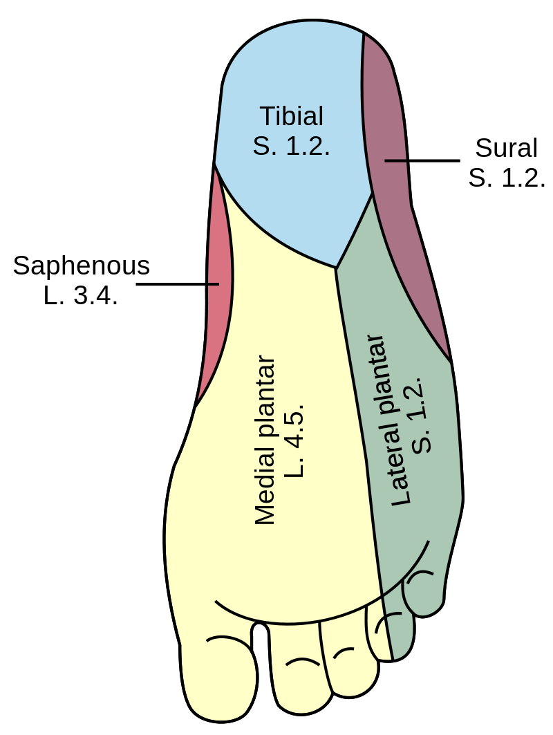
DERMATONES

Slide 7
FASCIA COMPARTMENTS OF THE SOLE
The sole of foot consist of two fascia compartments
SUPERFICIAL FACIA; Contains cutaneous nerves and superficial transvers metatarsal ligaments
DEEP FASCIA;
Plantar aponeurosis
Deep transverse metatarsal lgaments
Fibrous flexor sheaths in the toes

Slide 8
PLANTAR APONEUROSIS
It is a longitudinally arranged bundles of dense fibrous connective tissue investing the central plantar muscles
It is tougher, denser and longer compared to palmar aponeurosis
Arises posteriorly from calcaneus and functions like a superficial ligament
Longitudinal bundles of collagen fibres of the aponeurosis distally divides into five bands continuous with the fibrous digital sheath that enclosed the flexor tendons that passes to the toes
It is reinforced at the anterior end of the sole by superficial transverse metatarsal ligament

Slide 9
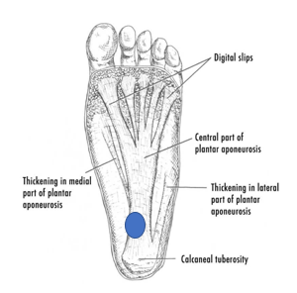
PLANTAR APONEUROSIS

Slide 10
SKELETAL FRAMEWORK
The foot is made up of 28 bones
Hindfoot; Talus and Calcaneus
Midfoot; navicular, cuboid and cuneiforms (3 bones)
Forefoot; metatarsals (5 bones) and phalanges (14 bones)
Two sesamoids

Slide 11
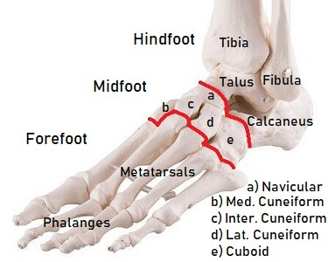
BONES OF THE FOOT

Slide 12
LAYERS OF THE FOOT
The foot is made up of 4 layers from superficial to deep
FIRST LAYER; Made up of the following muscles
- Abductor hallucis
- Flexor digitorum brevis
- Abductor digiti minimi
SECOND LAYER; Contains the following muscles
- Quadratus plantae (accessory flexors)
- Lumbricals
-Tendons of flexor digitorum longus

Slide 13
LAYERS OF THE FOOT CONT’D
THIRD LAYER; Consist of the following muscles-
-Flexor hallucis brevis
- Adductor hallucis
- Oblique head
- Transverse head
- Flexor digiti minimi brevis
FOURTH LAYER;
-Dorsal interossei (dab)
-Plantar interossei (pad)
-Peroneous longus
-Tibialis posterior

Slide 14
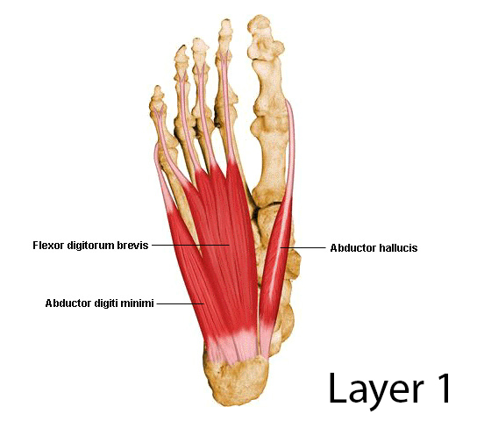
Muscles of first layer

Slide 15
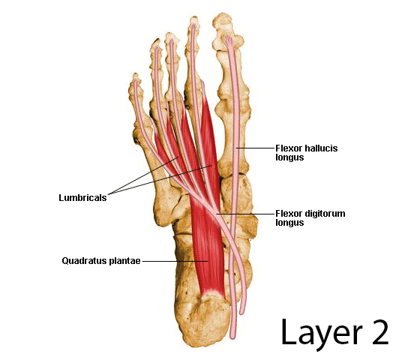
Muscles of 2nd layer

Slide 16
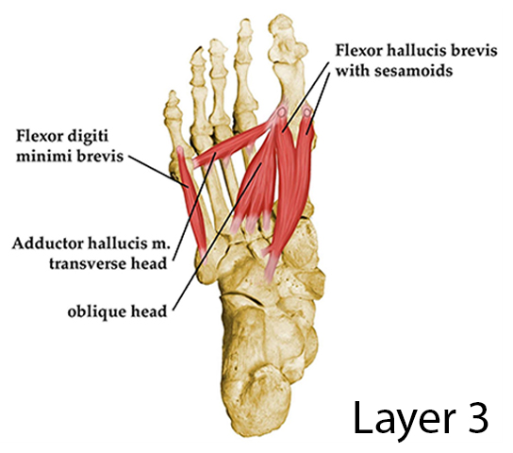
Muscles of 3rd layer

Slide 17
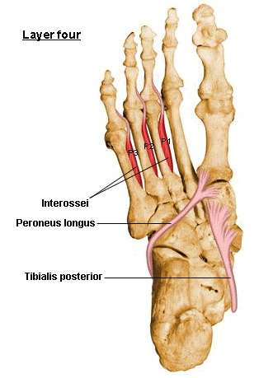
Muscles of 4th layer

Slide 18
COMPARTMENTS OF THE SOLE OF FOOT
The sole of the midfoot and forefoot is divided into 3 compartments by a vertical intermuscular septum extending deeply from the margins of the plantar aponeurosis toward the 1st and 5th metatarsals
Medial compartment of the sole; on the medial side
contents; Abductor hallucis, flexor hallucis brevis, tendon of the
flexor hallucis longus, medial plantar nerves and vessels

Slide 19
COMPARTMENTS CONT’D
(b) Central compartments;
CONTENTS; flexor digitorum brevis, tendons of flexor hallucis longus, flexor digitorum longus and associated muscles, quadratus plantae, lumbricals, adductor hallucis, lateral plantar nerves and vessels
(c) Lateral compartments; on the lateral side
CONTENTS; Abductor digiti minimi, flexor digiti minimi brevis

Slide 20
RETINACULAR CURTIS
This is a fibrous septa or highly developed skin ligament that divide the sole into fat-filled areas of shock-absorbing pad
It anchores the skin to the underlying deep fascia called PLANTAR APONEUROSIS
Improves the ‘grip’ of the sole

Slide 21
NERVE SUPPLY
The sole of foot is supplied by;
-Medial plantar nerve; give rise to digital branches, common digital
and terminal branches. Supplies the medial 2/3rd of the sole
- Lateral plantar nerve; gives rise to motor branches, a deep branch
and skin of the lateral 1 ½ of the digits
-All interossei are supplied by lateral plantar nerve (S2, S3)

Slide 22
BLOOD SUPPLY
The sole is supplied by medial and lateral plantar arteries which are branches from posterior tibial artery

Slide 23
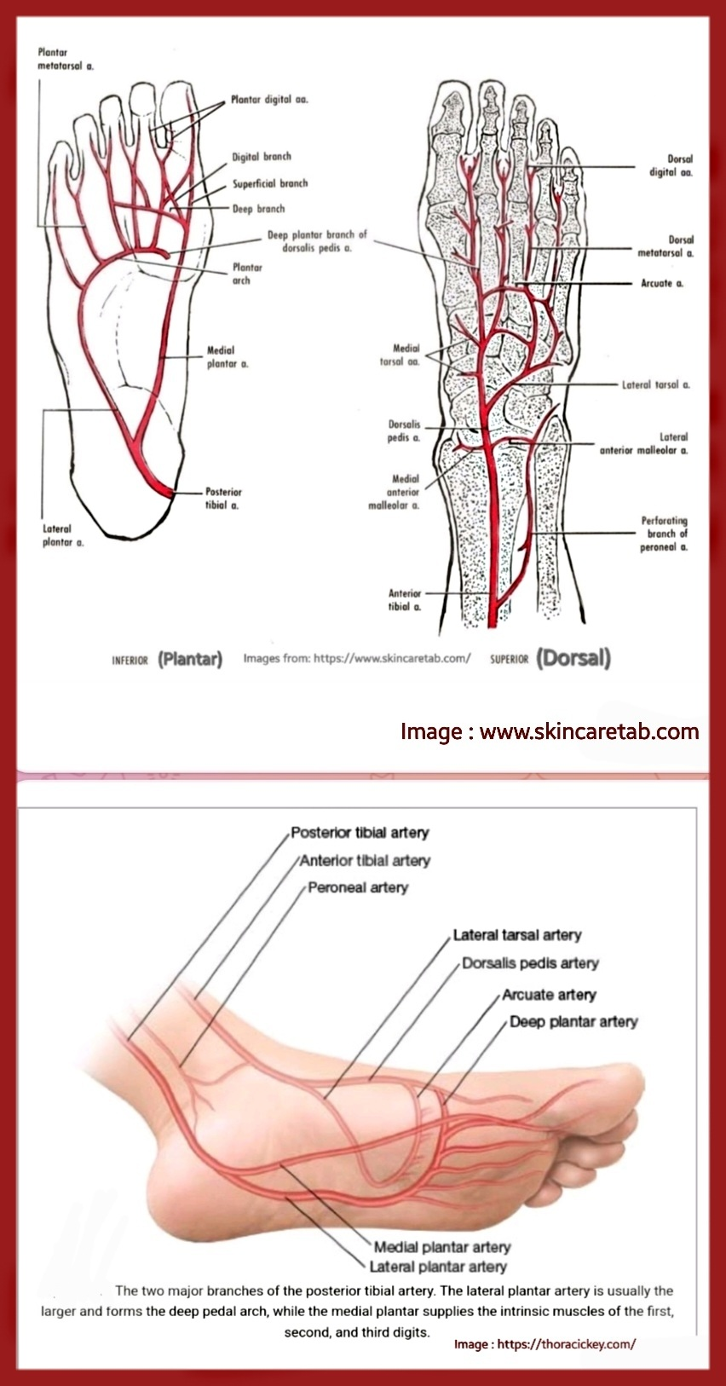
BLOOD SUPPLY

Slide 24
ARCHES OF THE FOOT
INTRODUCTION; The arches of the foot are curve-like arrangement of the bones of the foot.
It allows for weight distributions, acts as shock absorber and spring board for propelling the foot during walking, running and jumping
The resilient arches add to the foot’s ability to adopt to changes in surface contour
FORMATION- The bones of the foot are arranged in form of 2 longitudinal arches and one transverse arch
Giving it the unique structural adaptation

Slide 25
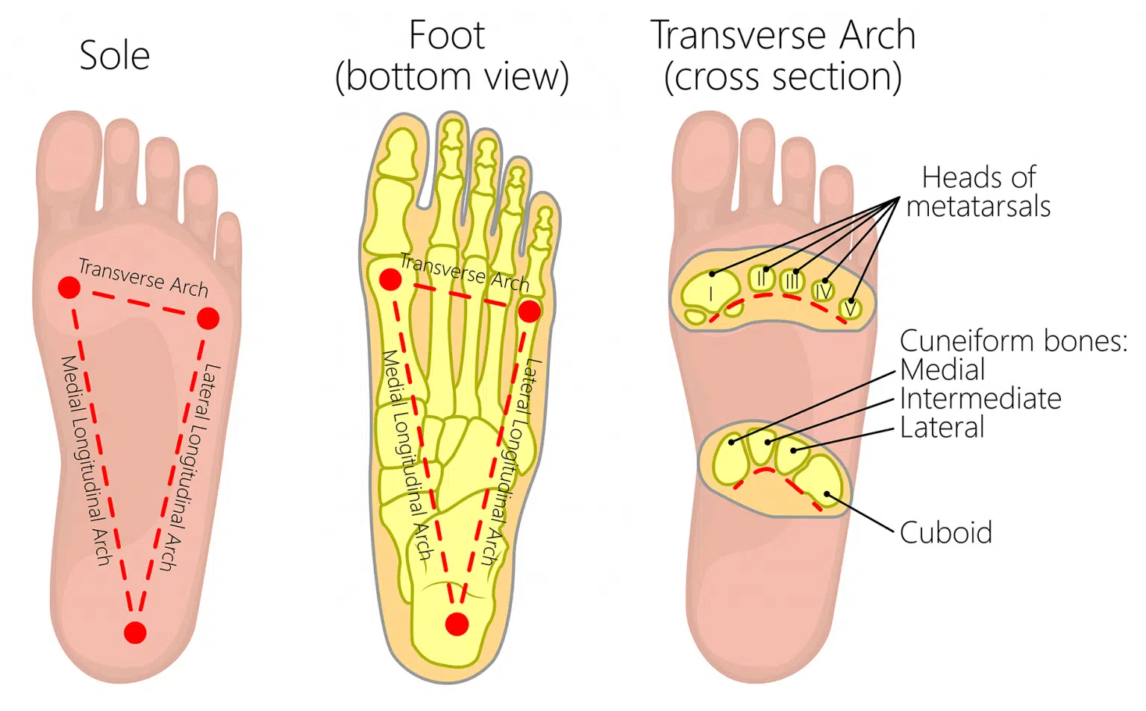
ARCHES OF THE FOOT

Slide 26
LONGITUDINAL ARCHES
Consist of the medial and lateral longitudinal arch
MEDIAL LONGITUDINAL ARCH; formed by calcaneus, talus, navicular, the 3 cuneiform bones and their 3 metatarsals
Pillars;
posteriorly; tuberosity of the calcaneus
anteriorly; heads of medial 3 metatarsal
anterior pillar is long and weak
Ends ; has 2 ends which are anterior and posterior ends
Sumits ; is the superior articular surface of the body of talus
Joint ; Talocalcaneonavicular joint

Slide 27
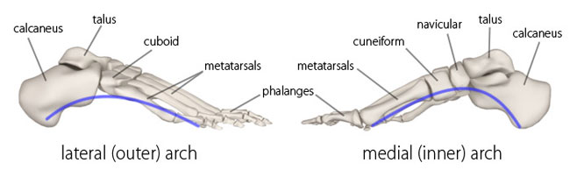
LONGITUDINAL ARCHES

Slide 28
LONGITUDINAL ARCHES CONT’D
LATERAL LONGITUDINAL ARCH; Formed by calcaneus, cuboid and the lateral 2 metatarsal bones
Sumit; is the cuboid
Its inferior surface is grooved by tendon of peroneus longus which passes transversely across the foot beneath it
For weight bearing and transfer

Slide 29
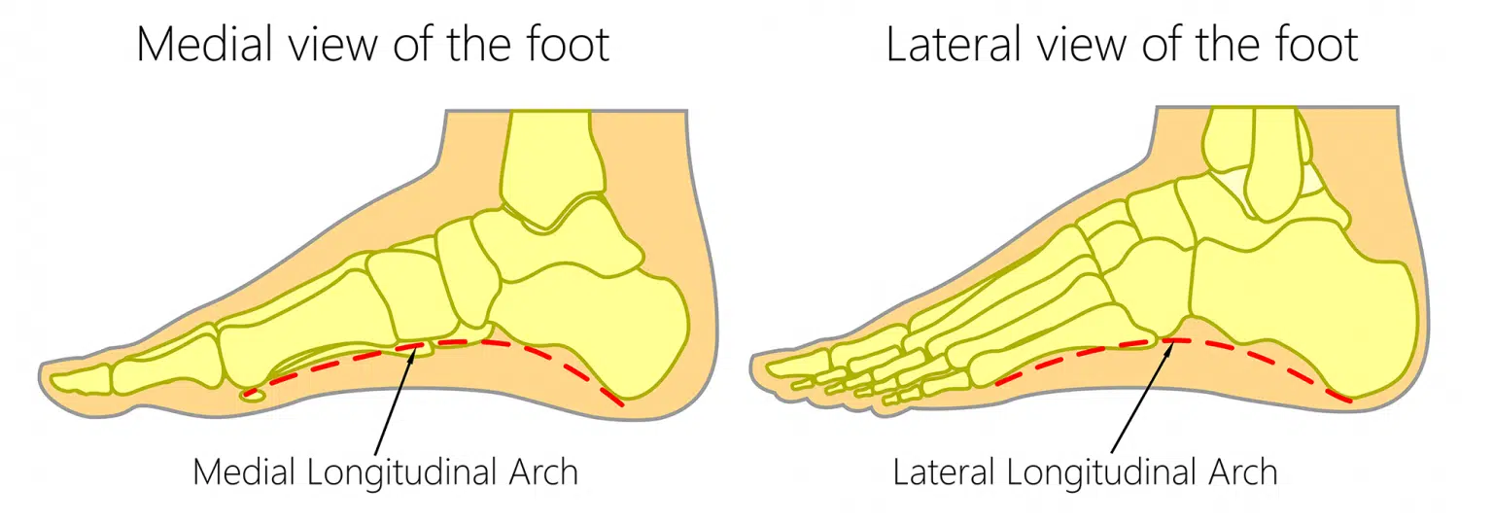
LONGITUDINAL ARCHES

Slide 30
TRANSVERSE ARCH
It is not a complete arch, more like half an arch.
Completed as an arch by the other foot
Formation; bases of the 5 metatarsals, the adjacent cuboid and cuneiform
This arched arrangement of the foot like the shape of a half dome, protect the structures in the sole of the foot, prevents compression.

Slide 31
MAINTENANCE OF THE ARCHES
Arches of the foot is maintained by tie, slings and beams formed by;
Shape of the interlocking bones
The ligaments;
i. dorsal plantar and interosseous ligaments
ii. Spring ligament from the sustentacular tali of the calcaneus
iii. Short plantar ligament
iv. Long plantar ligament
3. Tendons; fibularis longus tendon and tibialis posterior tendon
4. muscles; peroneus longus, tibialis anterior and posterior, flexor
hallucis longus, intrinsic muscles of the foot

Slide 32
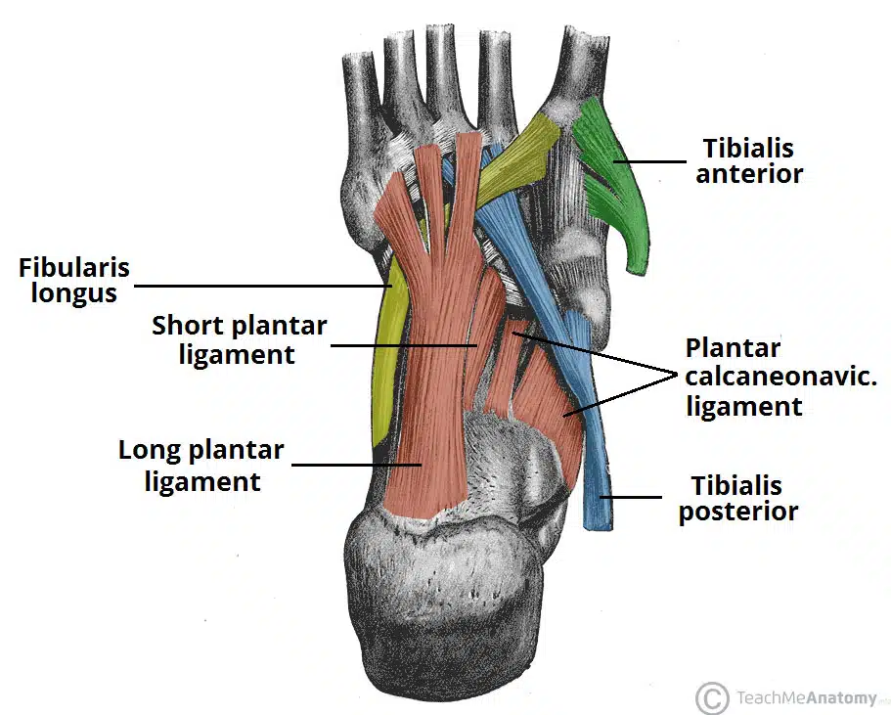
MENTAINANCE OF ARCHES

Slide 33
FUNCTIONS OF THE ARCHES
It allows for weight distributions,
Acts as shock absorber and spring board for propelling the foot during walking, running and jumping
The resilient arches add to the foot’s ability to adopt to changes in surface contour

Slide 34
CLINICAL SIGNIFICANCE
Medial plantar nerve entrapment; the medial plantar nerve can become compressed and irritated as it passes deep to the abductor hallucis muscle
This can cause aching, numbness, paraesthesia on the medial side of the sole of the foot
Repetitive eversion of the foot in some sports like gymnastics can compress the nerve
Pes planus (flat foot); absence of the longitudinal arch
Pes cavus ( high arches); the medial longitudinal arch become unusually high
CAUSES; idiopathic, hereditary, congenital (club foot)

Slide 35
REFERENCES
Drake, R., Vogl, W., Mitchell, A. & Gray, H. (2015). Gray's anatomy for students. Philadelphia, PA: Churchill Livingstone/Elsevier.
Moore, K. L., Dalley, A. F., & Agur, A. M. R. (2014). Clinically Oriented Anatomy (7th ed.). Philadelphia, PA: Lippincott Williams & Wilkins.
Standring, S. (2016). Gray's Anatomy (41st ed.). Edinburgh: Elsevier Churchill Livingstone

Slide 36
THANK YOU 4 LISTENING

